Slide 1



Tiva C – An Introduction
IEEEngage Workshop Series
- Gantabya Kadel
Sign In Here!

Slide 2
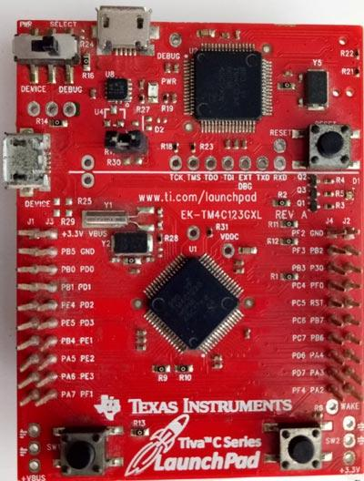
Tiva C
Aka LaunchPad
Family of Microcontrollers (MCs) from Texas Instruments
Relatively inexpensive MC when compared with other MCs.
32-Bit CPU @ 80 MHz – 120 MHz
40 – 80 Multifunctional Pins (GPIO)
May be configured as Analog or Digital I/O
ARM Cortex-M4 Architecture
ARM Cortex is the industry standard for MC

Slide 3
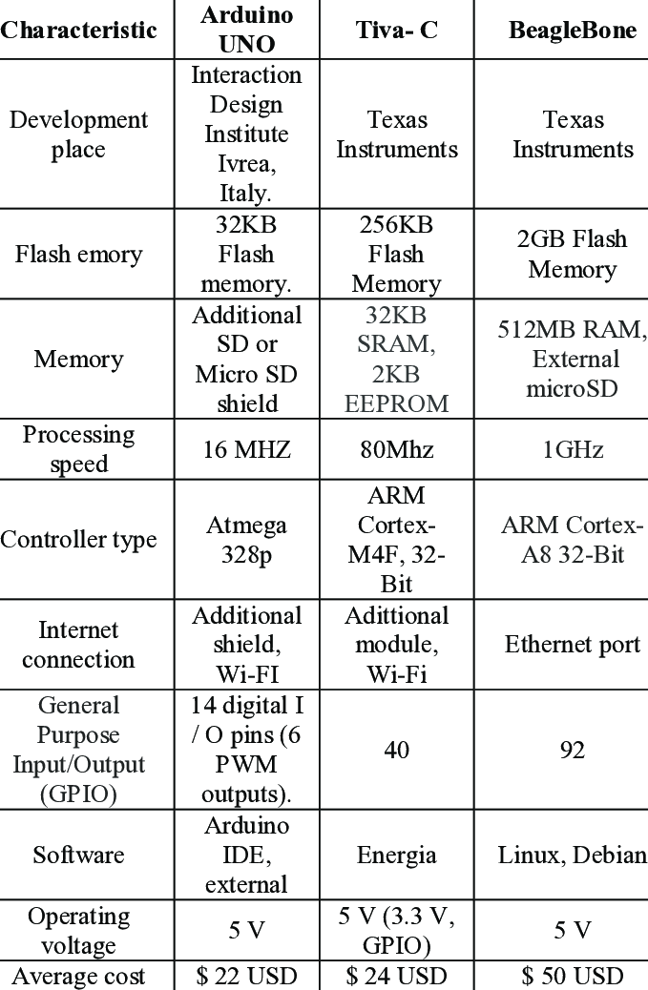
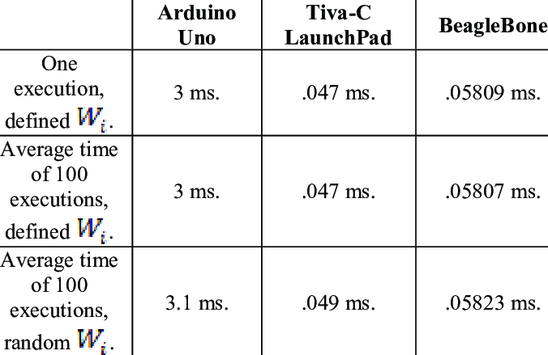
Tiva C VS Arduino Uno
Tiva CPU Performance >>>
Tiva C boards are 5-7x faster
Industry Standard MC
Allows for Educational Simulation of workplace MCs.
Both MCs are programmable in C
Arduinos are typically easier to use.
Arduinos are better for personal small scale DIY Projects.
Arduinos have greater online resources typically.
Notes:
SRC: https://www.researchgate.net/figure/Comparison-of-the-technical-characteristics-of-the-Arduino-UNO-Tiva-C-and-BeagleBone_tbl1_336009917
https://es.wikipedia.org/wiki/Tiva-C_LaunchPad

Slide 4
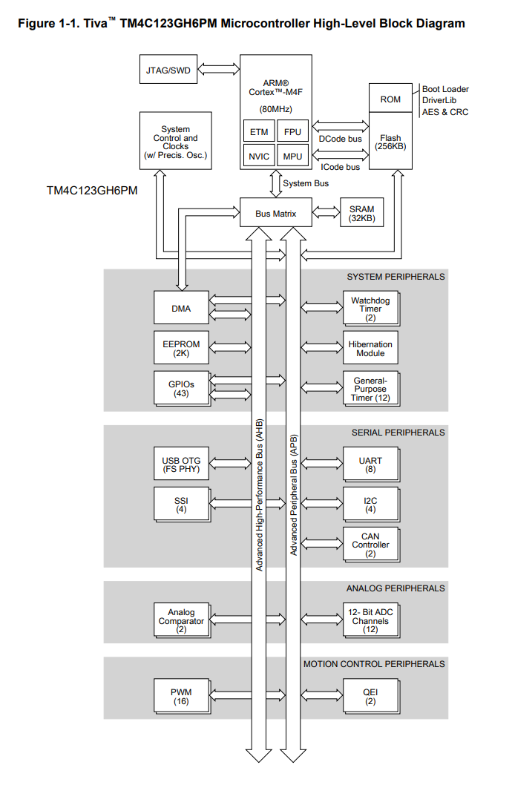
Tiva TM4C123GH6Pm MC High-Level Block Diagram

Slide 5
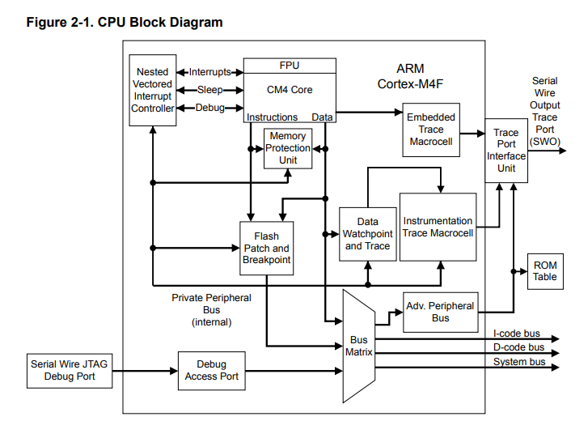
CPU Block Diagram

Slide 6
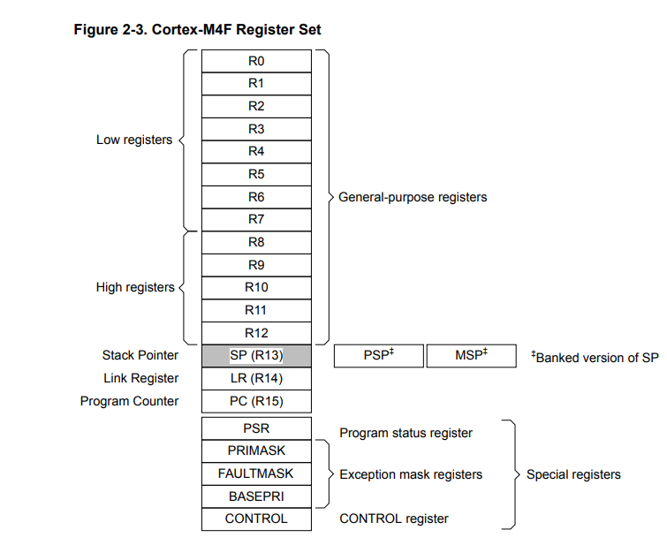
Cortex-M4F Register Set

Slide 7
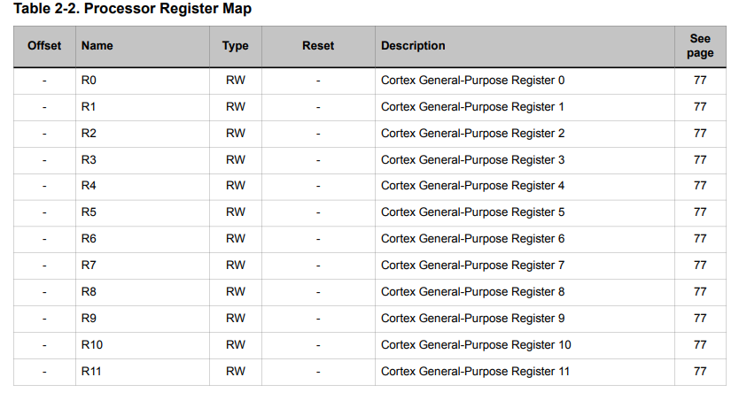
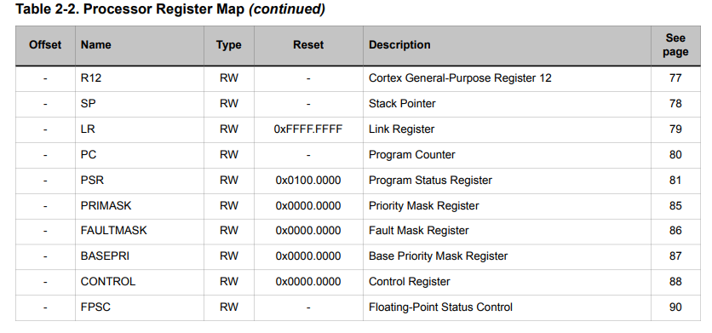
Processor Register Map

Slide 8
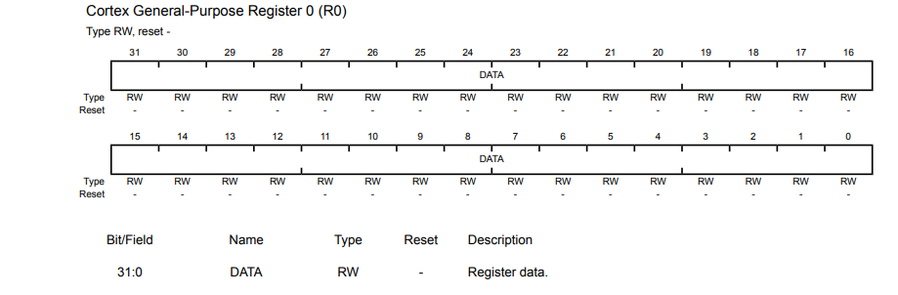
R0 – R12 Bit Fields
Read and Write Type.
32-bit (31:0)

Slide 9
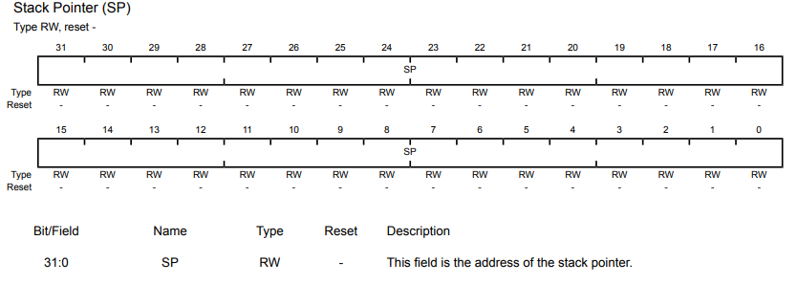
Stack Pointer Bit Field – R13

Slide 10
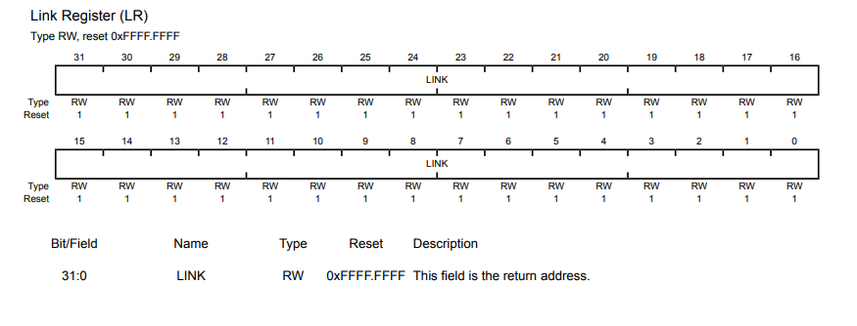
Link Register (LR) R14 Bit Field

Slide 11
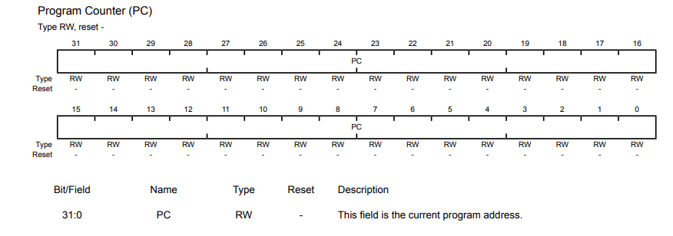
Program Counter (PC) R15 Bit-Field
You’ll see these again (in much more detail) during your coursework.
Especially Dr. D’s Microprocessor course.

Slide 12
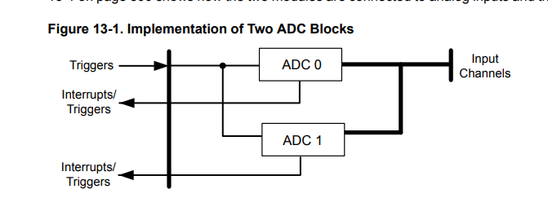
Analog-to-Digital Converter (ADC)
2 identical ADC modules
Share the same 12 analog input channels
Each Module operates independently
Can execute different sample sequences simultaneously.

Slide 13
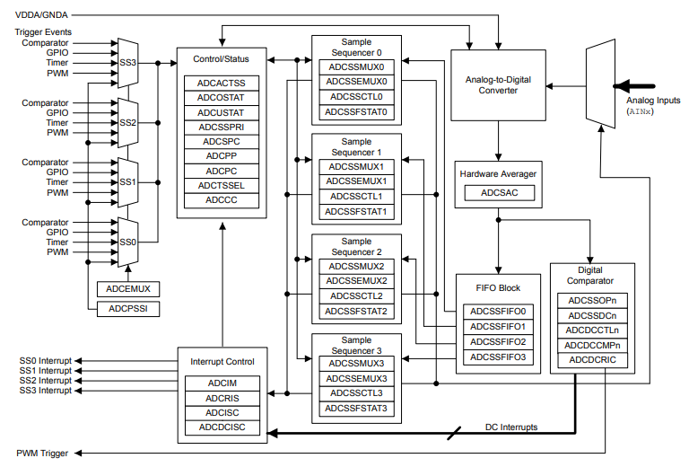
ADC Module Block Diagram

Slide 14
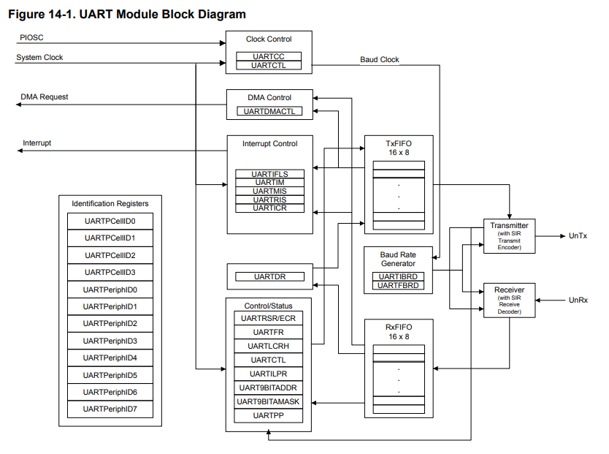
Universal Asynchronous Receivers/Transmitters (UARTs)
8 UART
Programmable baud-rate generator
Rate at which information is transmitted in a communication channel. [bps]
Allows for up to 5 Mbps for regular speed
Divide by 16
10 Mbps for high speed
Divide by 8
Separate 16x8 transmission (TX) & receive (RX) FIFO pins
FIFO => First In First Out
FIFO Trigger Levels: 1/8, 1/4, 1/2, 3/4, 7/8

Slide 15
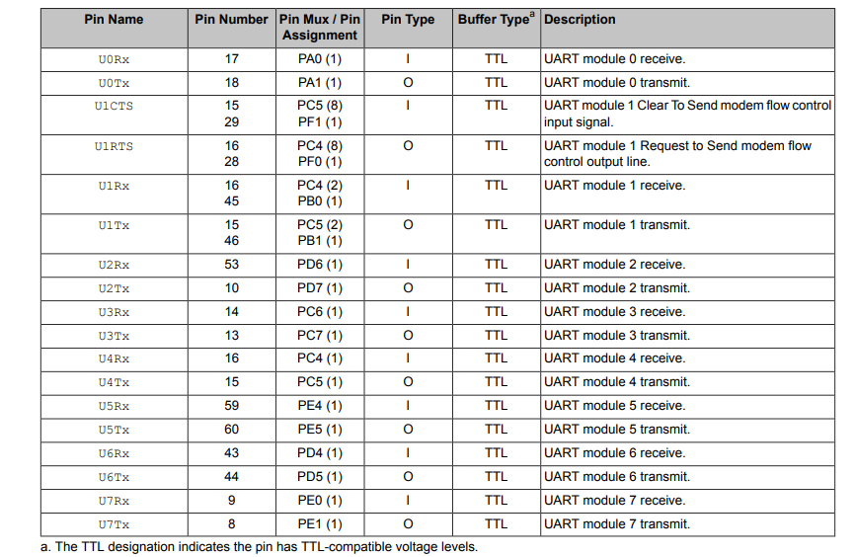
UART Signals

Slide 16


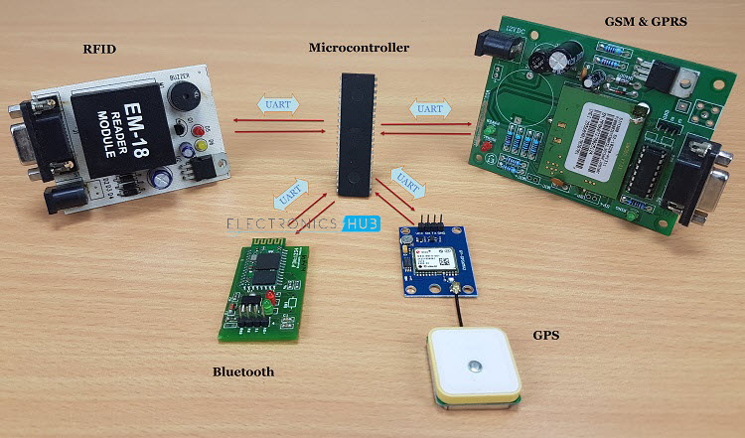
Real World Applications
Phones use ADC.
Voice in along 🡪 ADC 🡪 feeback to cellphone transmitter.
Digital Oscilloscope also contains ADC for converting Analog signal into a digital signal for display purposes & different other features
Medical Imaging like x-ray & MRI also uses ADC to convert images into Digital form before modification.
UART is used in GPS Receivers, Bluetooth modules etc.
Notes:
ADC example source: https://www.electricaltechnology.org/2019/02/analog-to-digital-converter-adc.html
UART source: https://www.electronicshub.org/basics-uart-communication/#:~:text=Today%2C%20UART%20is%20being%20used,heavy%20connectors%20at%20the%20back.

Slide 17
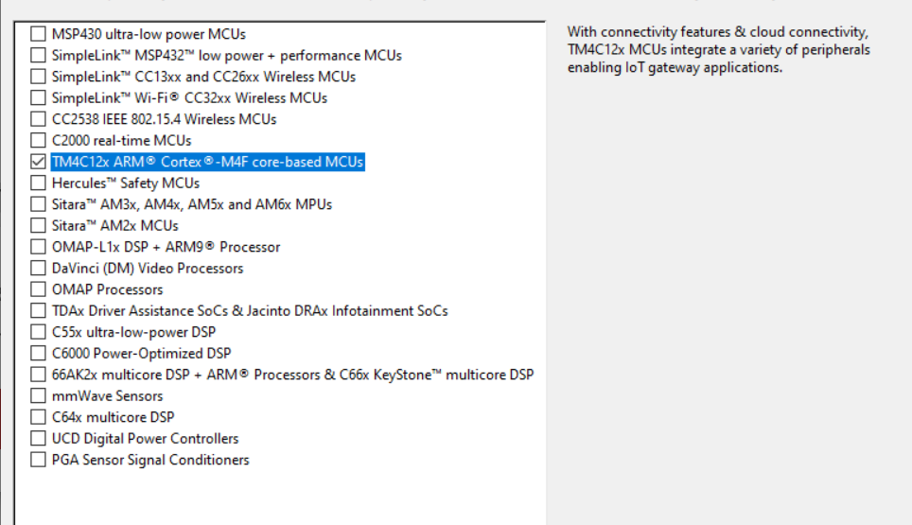
Setting Up IDE
Code Composer Studio (CCS)
Download Link: https://www.ti.com/tool/CCSTUDIO#downloads
Get the Latest Version … although any other version works.
Just select the TM4C support …. It’s the ARM tiva C support.
Install needed things as requires … prolly don’t need anything extra.

Slide 18
Download Software Dev Kit
https://www.ti.com/tool/SW-TM4C
Gives us important libraries to use for Tiva C development.
Download the latest version for the board in use
EK-TM4C123GXL
You can also download the package for all of Tiva C series if you prefer.

Slide 19
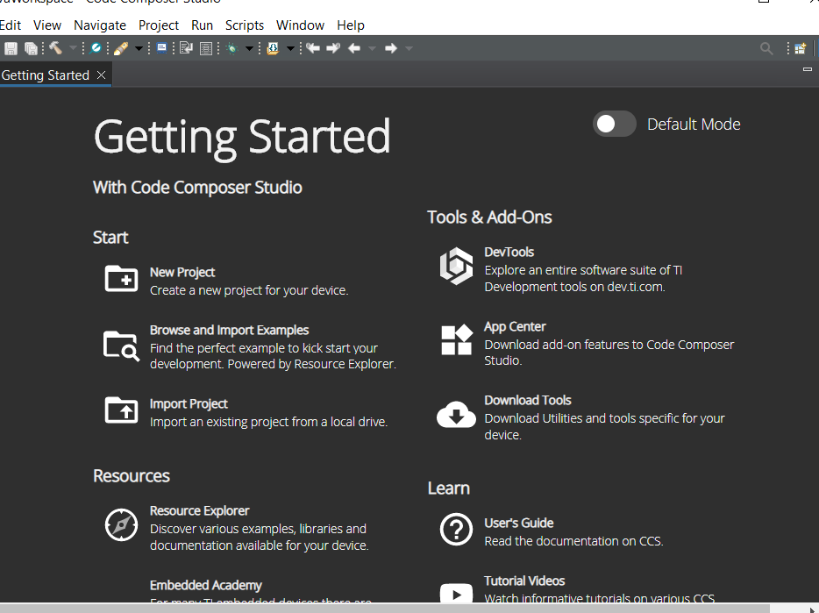
Getting Started
New Project

Slide 20
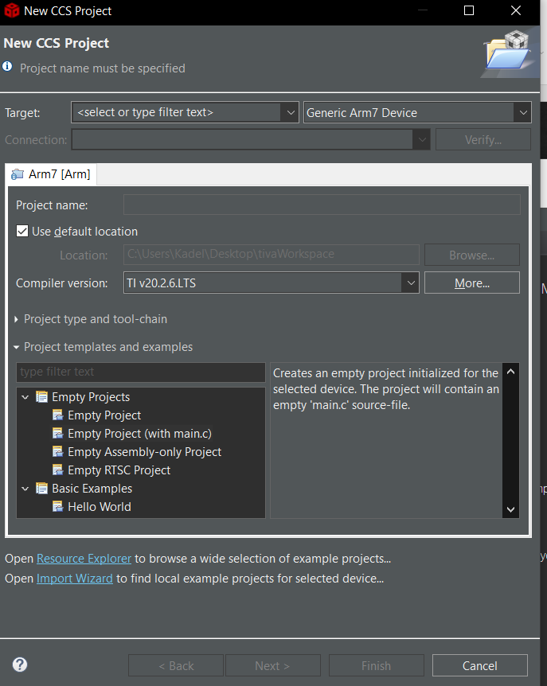
Window Below or similar should populate

Slide 21
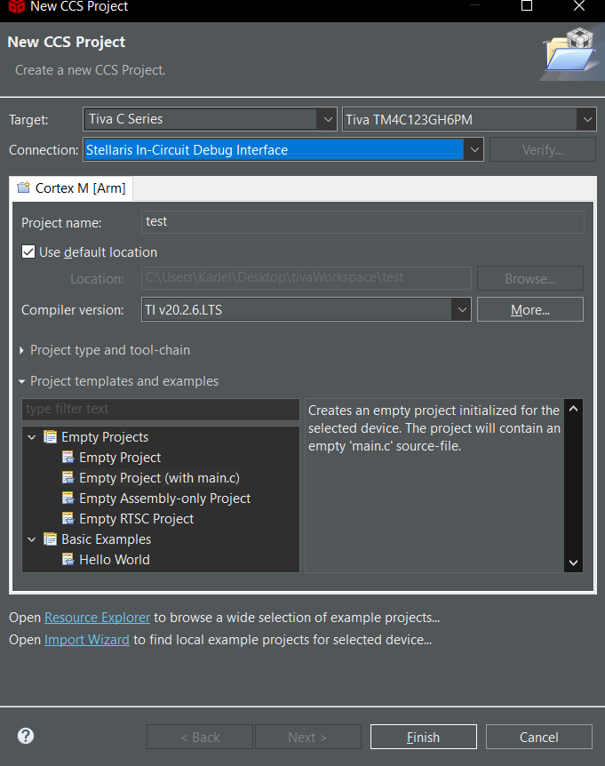
Target: Tiva C Series
Tiva TM4C123GH6PM
Connection: Stellaris In-Circuit Debug Interface
For Name Use What you Prefer
Select Empty Projects >> Empty Project (with main.c)
And we code a basic Example

Slide 22
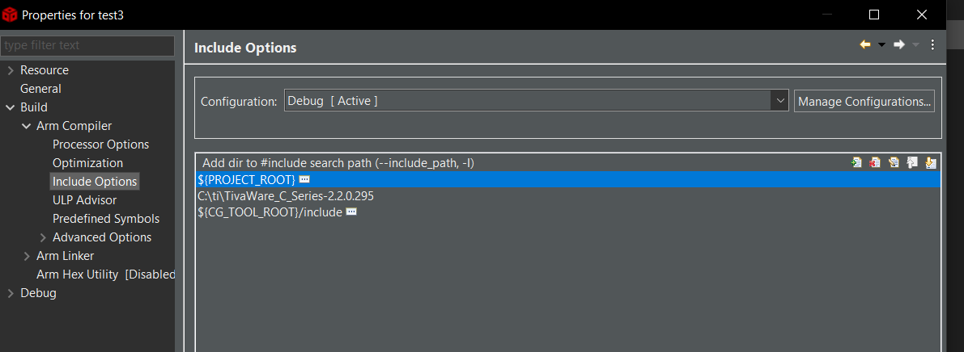
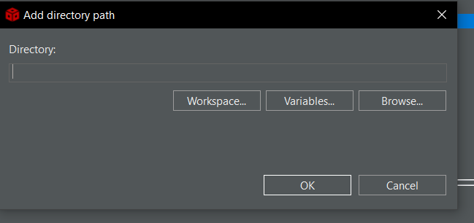
Additional Steps
Create New Project
Blank with Main.c example file
Right-Click on project
Select Properties
Click on Arm Complier under Build
Click on Include Options
Click on Add
This window will generate. Click on Browse. Go to the ti directiroy (should be on the path shown)
Select the “TivaWare_C_Series-2.2.0.295” folder or whichever version you have. Then click on apply and close

Slide 23
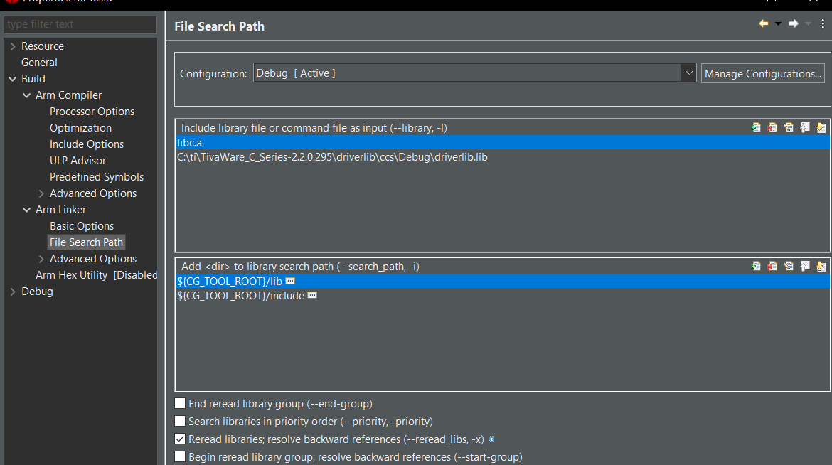
Additional Steps Continued
Repeat the process to go to properties window.
Go to Arm Linker
Click File Search Path
Click on Add
A similar window to the last Add option will generate
Click on Browse
Browse to your TivaWare_C library
Double Click TivaWare_C folder
Double Click on driverlib folder
Double Click on ccs
Double Click Debug folder
Find “driverlib.lib” file and add it.
Click on Apply & Close
We’re now ready to code!

Slide 24
Example Code
https://drive.google.com/file/d/1qMrTOH-HKbivWFZGWdN7vf3yLuILMCB6/view?usp=sharing
Notes:
https://www.instructables.com/Blinking-LED-in-Tiva-C-Board-TM4C123G/

